Slide 1
DEVELOPMENT OF DEVELOPMENT OF THE FACIAL SKELETON AND ASOCIATED STRUCTURES
Prof Peter Gichangi
March 2017

Slide 2
OBJECTIVES
Describe development of facial skeleton including: face, nose, palate and paranasal sinuses
Describe associated developmental defects

Slide 3
INTRODUCTION
During the development of the face and nose, there is serial closing and then the re-opening of a space.
This is seen in the separation of the nasal and oral cavities, and the nostrils.
After the formation of the head fold, there is formation of two prominent swellings on the ventral aspect of the embryo separated by the stomatodaeum.
Mesoderm covering the developing forebrain proliferates, and forms a downward projection that overlaps the upper part of the stomatodaeum.
This downward projection is called the frontonasal process. which filled with cranial neural crest.

Slide 4
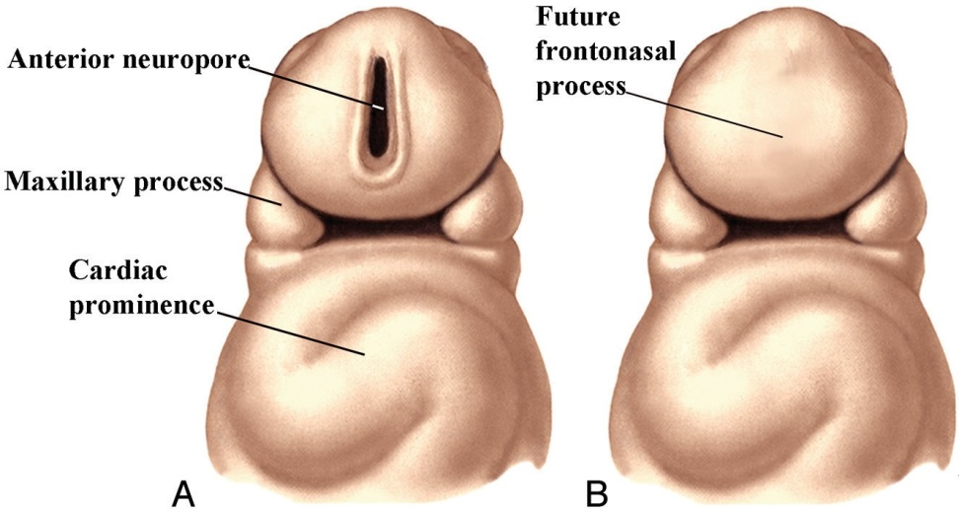
Drawing (A) of a ventral view of a 3- to 4-week embryo shows the anterior neuropore and the early formation of the maxillary processes. Drawing (B) in the late 4th week shows closure of the anterior neuropore and the location of the future frontonasal process. Note the cardiac prominence

Slide 5
Early craniofacial development is characterized by several massive migrations and displacements of cells and tissues.
Face development is based on the timing, location, and interactions of individual streams of neural crest and mesodermal cells.
The early cranial mesoderm consists mainly of the paraxial and prechordal mesoderm.
Mesenchymal cells originating in the paraxial mesoderm form the connective tissue and skeletal elements of the caudal part of the cranium and the dorsal part of the neck.

Slide 6
Myogenic cells from paraxial mesoderm undergo extensive migrations to form the bulk of the muscles of the cranial region.
In the face and ventral pharynx, this connective tissue forming muscles with myogenic cells is of neural crest origin.
The precordal mesoderm may contribute myoblasts which form the extraocular muscles.
The lateral plate mesoderm gives rise to endothelial and smooth muscle cells.
Note the formation of ectodermal placodes which combines with cells of the neural crest to form parts of sense organs and ganglia of certain cranial nerves.

Slide 7
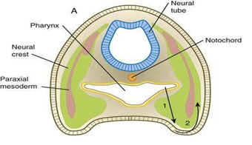
Relationship of paraxial mesoderm and neural crest cells

Slide 8
The ectoderm overlying the frontonasal process soon shows bilateral localised thickenings – the nasal placodes, that are situated a little above the stomatodaeum.
The formation of nasal placodes is induced by the underlying forebrain.
The placodes soon sink below the surface to form nasal pits.
The pits are continuous with the stomatodaeum.
The edges of each pit are raised above the surface:
The medial raised edge is called the medial nasal process and
The lateral edge is called the lateral nasal process.

Slide 9
FORMATION OF THE FACE
The major development of the facial region occurs between the 4th and 8th embryonic weeks.
Development of the face and jaws is a complex three process involving the patterning, outgrowth, fusion, and molding of various tissue masses.
Three sopurces: head ectoderm; mesoderm and neural crest mesenchyme from the forebrain the first two rhombomeres.
The forebrain acts as a signaling center for early facial development with stomodeum as the reference point.
In the 5th week, the oropharyngeal membrane disintegrates, creating communication between the foregut and the outside.

Slide 10
5th week mesenchymal growth in the first branchial arch produces first the maxillary process and then the faster growing mandibular process on each side of the future face.
The mandibular processes rapidly extend to the facial midline and merge.
The stomodeum is now surrounded by the frontonasal process above, the paired maxillary processes on either side, and the paired mandibular processes below (future lower jaw).
The lower face (maxillary region and lower jaw) is derived from the first pharyngeal arch.

Slide 11
The face is derived from the following primordia that lie around the stomodeum:
Unpaired frontonasal prominence
First pharyngeal arches derivatives
Paired maxillary prominences
Paired mandibular prominences
Nasal primordia derivatives
Paired nasomedial processes
Paired nasolateral processes

Slide 12
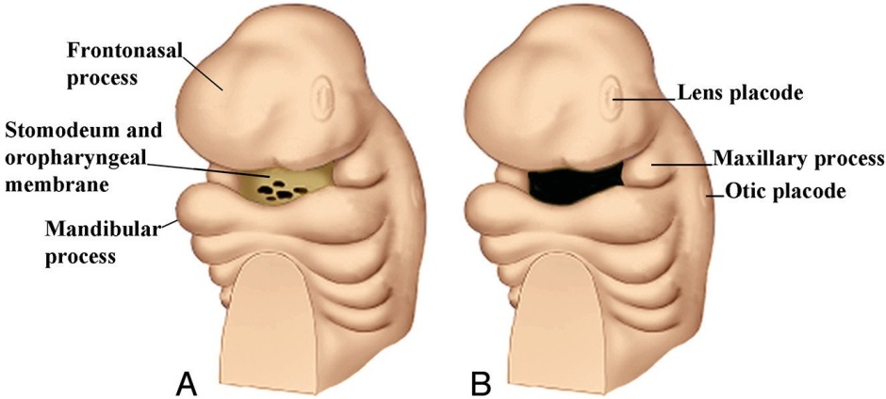
Anterior oblique drawing of an embryo in the late fourth week (A) shows the stomodeum with the oropharyngeal membrane surrounded by the further development of the frontonasal process and the maxillary and mandibular processes. B, Drawing shows the breakdown of the oropharyngeal membrane by the fifth week. The early appearance of the lens and otic placodes is also seen.

Slide 13
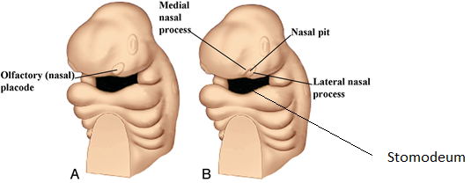
Anterior oblique drawing (A) of a 5-week embryo showing the appearance of the nasal (olfactory) placode. B, Drawing shows the development of the medial and lateral nasal processes forming a downward-facing “horseshoe” around the sinking nasal placode, which forms the nasal pit.

Slide 14
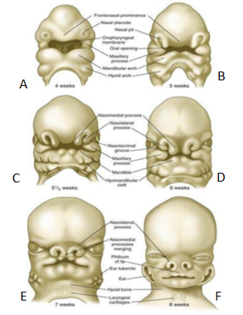
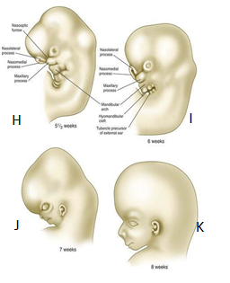
Frontal and lateral views of heads of human embryos 4 to 8 weeks of age.
Further development of the face is due mainly to the growth in size and change in position of its components. The eyes migrate medially due to the expansion of the frontal bones. Their forwards directed position confers to man and higher primates stereoscopic vision and depth perception and contributes to increasing skull height.

Slide 15
FORMATION OF JAWS
The upper jaw contains a mixed population of neural crest cells derived from the forebrain and midbrain, whereas the lower jaw contains mesenchymal cells derived from midbrain and hindbrain (rhombomeres 1 and 2) neural crest.
The specific morphology of facial skeletal elements is determined by signals passed from the pharyngeal endoderm to the facial ectoderm and then to the neural crest precursors of the facial bones.
The maxillary and mandibular processes have traditionally been considered to be derivatives of the first pharyngeal arch.
MMED? Is this correct?
There is recent research suggesting that although some of the cells that form the maxillary process arise from the first arch, many mesenchymal cells of the maxillary process are not first-arch derivatives, but instead come from other areas of cranial neural crest.

Slide 16
The outgrowth of the frontonasal prominence and the maxillary and mandibular processes depends on mesenchymal-ectodermal interactions.
Despite the relatively featureless appearance of the early mandibular process (first pharyngeal arch), the mediolateral (oral-aboral) and proximodistal axes are tightly specified.
This can explain why only certain parts are affected when gene mutations occur.
Growth of the jaws is influenced by various growth factors, especially the bone morphogenetic proteins (BMPs), which, at different stages, are produced in either the ectoderm or the mesenchyme and can have strikingly different effects.
The upper jaw and lip are formed as a result of the fusion and merging of the medial nasal, lateral nasal and maxillary prominences.

Slide 17
The merged nasomedial processes form the intermaxillary segment, which is a precursor for
(1) the philtrum of the lip
(2) the premaxillary component of the upper jaw
(3) the primary palate
Between the maxillary process and the nasal primordium (nasolateral process) is a nasolacrimal groove (naso-optic furrow) that extends to the developing eye.
The ectoderm of the floor of the nasolacrimal groove thickens to form a solid epithelial cord, which undergoes canalization and forms the nasolacrimal duct and, near the eye, the lacrimal sac.
The nasolacrimal duct extends from the medial corner of the eye to the nasal cavity (inferior meatus) and, in postnatal life, acts as a drain for lacrimal fluid.
Other fusions:
Nasomedial process fuses with the maxillary process.
Over the region of the nasolacrimal groove, the nasolateral process merges with the superficial region of the maxillary process.
Between the nasomedial and maxillary process is a space called the bucconasal groove.
The closure across the bucconasal groove is not by fusion but by the growth of an epithelial membrane, the bucconasal membrane.
The overall fusion across the bucconasal groove is often referred to as the nasal fin, and it separates the primitive nasal cavity from the primitive oral cavity.

Slide 18
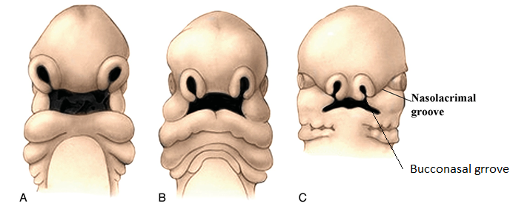
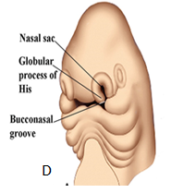
Frontal drawings of 4- to 5-week (A) and 5- to 6-week (B) embryos illustrate the progressive displacement of the nasal sacs toward the midline as a result of medial growth of the maxillary processes. Frontal view of a 6- to 7-week embryo (C) shows the nasolacrimal groove

Slide 19
The lower jaw is formed in a simpler manner.
The bilateral mandibular prominences enlarge, and their medial components merge in the midline, to form the point of the lower jaw.
The midline dimple that is seen in the lower jaw of some individuals is a reflection of variation in the degree of merging of the mandibular prominences.
A prominent cartilaginous rod called Meckel’s cartilage differentiates within the lower jaw.
Derived from neural crest cells of the first pharyngeal arch, Meckel’s cartilage forms the basis around which membranous bone (which forms the definitive skeleton of the lower jaw) is laid down.

Slide 20
Shortly after the basic facial structures take shape, they are invaded by mesodermal cells associated with the first and second pharyngeal arches.
These cells form the muscles of mastication (first-arch derivatives, which are innervated by cranial nerve V) and the muscles of facial expression (second-arch derivatives, which are innervated by cranial nerve VII).
At the level of individual muscles, highly coordinated spatiotemporal relationships between mesodermal and neural crest cells are very important in the determination of muscle attachments and the overall shape of the muscles.
Although the basic structure of the face is established between 4 and 8 weeks, changes in the proportionality of the various regions continue until well after birth.
In particular, the midface remains underdeveloped during embryogenesis and early postnatal life.

Slide 21
TEMPORAL MANDIBULAR JOINT
The temporomandibular joint is a complex synovial joint between the mandibular condyle and the squamous part of the temporal bone.
It has an articular disk between the two bones.
The disc and joint cavity formation during TMJ development are complex and rather unique processes that are distinct from those occurring in developing joints at other skeletal sites.
This joint is formed late during development, first appearing as mesenchymal condensations associated with the temporal bone and mandibular condyle during the 7th week of development.
The condylar condensation differentiates into cartilage, forms a growth plate-like structure, and becomes distinguishable into four distinct portions along its main axis:
a fibrous cell layer,
a polymorphic progenitor cell layer,
a zone of flattened chondrocytes, and
a zone of hypertrophic chondrocytes
The elongation process is largely due to appositional growth at its apical end which is different from other long bones which elongate by mitotic activity of chondrocytes within the proliferative zone of the growth plate.
The articular disk and capsule begin to take shape a week later, and the actual joint cavity forms between weeks 9 and 11 weeks.
The articular disc develops a separate flat-shaped mesenchymal condensation located between condyle apex and temporal bone.
TMJ development is considered to be in three phases:
1) the blastematic stage (weeks 7–8 of development);
2) the cavitation stage (weeks 9–11 of development); and
3) the maturation stage (after week 12 of development).

Slide 22
MIDFACIAL DEVELOPMENT
During the 5th week, while the olfactory portions of the nasal sacs are developing, the maxillary processes grow medially resulting in medial displacement of the nasal sacs.
At the same time, there is also some ventrolateral expansion of each medial nasal process, which causes compression of each nasal sac aperture into a slit-shaped opening.
Merging of the nasomedial process (globular process of His forms the intermaxillary segment, primary palate.

Slide 23
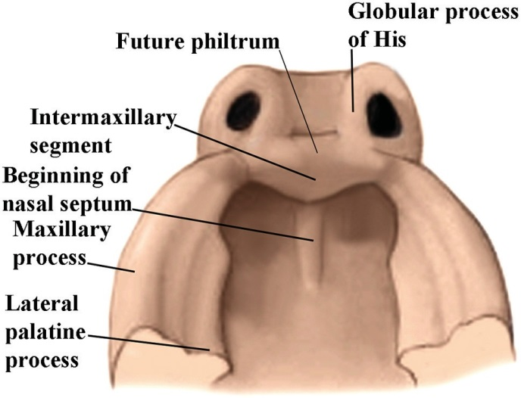
Drawing from below of a 6-week fetus showing the emergence of the intermaxillary segment below the medial nasal processes.

Slide 24
UPPER LIP
Each maxillary process now grows medially and fuses, first with the lateral nasal process, and then with the medial nasal process.
The two merged medial nasal processes then form the philtrum and columella and complete the upper lip.
The fusion of the two medial nasal processes displaces the frontonasal process superiorly and posteriorly.
Although the frontonasal process formed the upper border of the stomodeum, it does not contribute to the definitive upper lip, jaw, or nasal tip.
The medial migration of the maxillary processes forms not only the lateral upper lip but the upper cheek regions, resulting in continuity of the upper jaw and lip.
The medial and lateral nasal processes also fuse with each other.
In this way the nasal pits (now called external nares) are cut off from the stomodaeum.

Slide 25
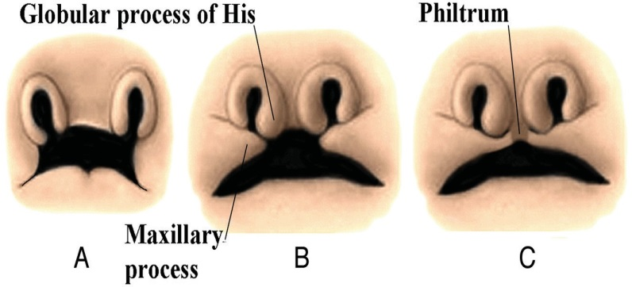
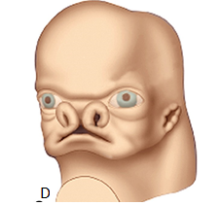
Frontal drawings of the upper lip region in embryos at 5 (A) , 6 (B) and 7 (C) weeks show the progressive medial growth of the maxillary processes toward the midline.

Slide 26
Formation of Lower Lip
The mandibular processes of the two sides grow towards each other and fuse in the midline.
They now form the lower margin of the stomatodaeum.
The fused mandibular processes give rise to the lower lip, and to the lower jaw.
Formation of Cheeks
After formation of the upper and lower lips, the stomatodaeum (which can now be called the mouth) is very broad.
In its lateral part, it is bounded above by the maxillary process and below by the mandibular process.
These processes undergo progressive fusion with each other to form the cheeks.

Slide 27
FORMATION OF NOSE
At the end of the 4th week, the ectoderm on each side of the frontal prominence thickens and forms the nasal or olfactory placodes.
The nasal placodes originate from ecotoderm on the anterolateral edge of the frontalnasal process before closure of the neural tube.
Each nasal placode begins to deepen forming nasal pit as a result of active growth of the placodal epithelium and proliferation of the mesenchyme deep to the edges of the placode.
The mesenchyme around the placodes proliferates and causes elevations on both sides with the lateral one forming first followed by the medial one.
These elevations are called nasomedial and lateral nasolateral folds or processes, horseshoe-shaped with open ends facing the future mouth.

Slide 28
The nasal pits deepen to form nasal sacs which continue to grow towards the oral cavity.
By 6th week, only a thin oronasal/bucconasal membrane separates the oral cavity from the nasal cavity.
The oronasal membrane soon breaks down, thereby making the nasal cavities continuous with the oral cavity through openings behind the primary palate called nasal choanae.
Shortly after breakdown of the oronasal/bucconasal membrane, the outer part of the nasal cavity becomes blocked with a plug of epithelial cells, which persists until the end of the fourth month.
The region occupied by the plug will become the nasal vestibule and the future limen nasi, which is a ridge separating the nasal cavity proper from the vestibule of the nose.
As a consequence, the nasal vestibule consists of skin and adnexa derived from ectoderm.
If this epithelial plug does not disintegrate, atresia of the nostril will

Slide 29
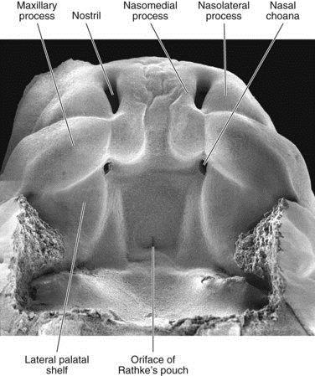
Scanning electron micrograph of 7-week human embryo.

Slide 30
The medial nasal process is more prominent than the lateral nasal process, extending farther ventrally and caudally.
Each medial nasal process has an enlarged caudal end that is called the “globular process of His ”.
As the nasal primordia merge toward the midline during weeks 6th and 7th weeks, the nasomedial processes form the tip and crest of the nose along with part of the nasal septum, and the nasolateral processes form the wings (alae) of the nose.
The receding frontonasal process contributes to part of the bridge of the nose.
On each side of the face, along the junction between the maxillary and lateral nasal processes is the nasolacrimal groove (naso-optic furrow).

Slide 31
The nasolacrimal groove extends between the developing lower lateral nose and the medial orbit.
These ducts usually become completely patent only after birth.
The epithelium of each nasal pit induces the surrounding neural crest mesenchyme to form a cartilaginous capsule around it.
In a three-dimensionally complex manner, the medial parts of the nasal capsules combine with more centrally derived deep neural crest mesenchyme to form the midline nasal septum and ethmoid bones.
The lateral region of the nasal capsule forms the nasal bones.
During the 3rd month, shelflike structures called nasal conchae form from the ethmoid bones on the lateral wall of the nasal cavity.
The size and shape of these structures have a significant impact on the form of the face during its postnatal growth period.

Slide 32
At 6 to 7 weeks, a pair of epithelial ingrowths can be seen in each side of the nasal septum near the palate.
Developing as invaginations from the medial portion of the nasal placode, these diverticula, known as vomeronasal organs, reach a maximum size of about 6 to 8 mm at around the sixth fetal month and then begin to regress, leaving small cystic structures.
In most mammals and many other vertebrates, the vomeronasal organs, which are lined with a modified olfactory epithelium, remain prominent and are involved in the olfaction of food in the mouth or sexual olfactory stimuli (e.g., pheromones).

Slide 33
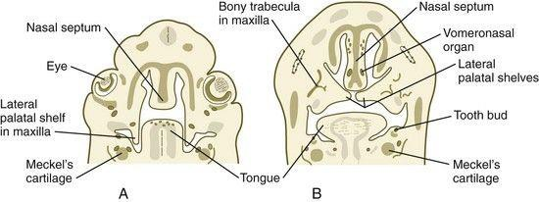
A and B, Frontal sections through the human head, showing fusion of the palatal shelves. Note vomeronasal organ in the nasal septum

Slide 34
The dorsal most ectodermal epithelium of the nasal pits undergoes differentiation as a highly specialized olfactory epithelium.
Beginning in the embryonic period and continuing throughout life, the olfactory epithelium is able to form primitive sensory bipolar neurons, which send axonal projections toward the olfactory bulb of the brain.
Preceding axonal ingrowth, some cells break free from this epithelium and migrate toward the brain.
Other cells migrating from the olfactory placode (specifically, the vomeronasal primordium) synthesize luteinizing hormone–releasing hormone and migrate to the hypothalamus, the site of synthesis and release of this hormone in adults.
The embryonic origin of these cells in the olfactory placode helps to explain the basis for Kallmann’s syndrome, which is characterized by anosmia and hypogonadotropic hypogonadism.
Cells of the olfactory placode also form supporting (sustentacular) cells and glandular cells in the olfactory region of the nose.
Physiological evidence shows that the olfactory epithelium is capable of some function in late fetal life, but full olfactory function is not attained until after birth.

Slide 35
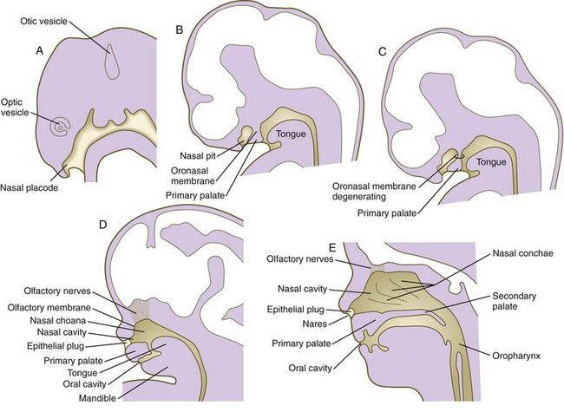
Sagittal sections through embryonic heads with special emphasis on development of the nasal chambers. A, At 5 weeks. B, At 6 weeks. C, At weeks. D, At 7 weeks. E, At 12 weeks.

Slide 36
Anomalies of the Nasal Cavity
There may be atresia of the cavity at the external nares, at the posterior nasal aperture, or in the cavity proper.
This may be unilateral or bilateral.
Very rarely, there may be total absence of the nasal passages.
Congenital defects in the cribriform plate of the ethmoid bone may lead to a communication between the cranial cavity and the nose.
The nasal septum may not be in the middle line, i.e. it may be deflected to one side.
The septum may be absent.
The nasal cavity may communicate with the mouth.

Slide 37
PARANASAL SINUS
The paranasal sinuses namely the frontal, maxillary, ethmoidal and sphenoidal, develop during the 3rd month as diverticula of the nasal mucosa into the corresponding bones after which they are named.
The growth of the sinuses and their pneumatization occurs at different rates.
The maxillary and sphenoidal sinuses are the first to appear before birth followed by others after birth.
The frontal sinuses do not develop into the frontal bones until the second year and they may be absent.
The paranasal sinuses reach their maximum size around puberty.
Enlargement of paranasal sinuses is associated with overall enlargement of the facial skeleton, including the jaws.
This provides space in the jaws for growth and eruption of teeth.
Absences of frontal and sphenoidal sinuses are characteristics feature of mongolism.

Slide 38
FORMATION OF PALATE
The early embryo possesses a common oronasal cavity.
The palate forms between 6 and 10 weeks to separate the oral from the nasal cavity.
The palate is derived from three primordia: an unpaired median palatine process, a pair of lateral palatine processes with contribution from nasal septum.
The median palatine process is an ingrowth from the merged nasomedial processes.
As it grows, the median palatine process forms a triangular bony structure called the primary palate.
In postnatal life, the skeletal component of the primary palate is referred to as the premaxillary component of the maxilla.
The four upper incisor teeth arise from this structure.

Slide 39
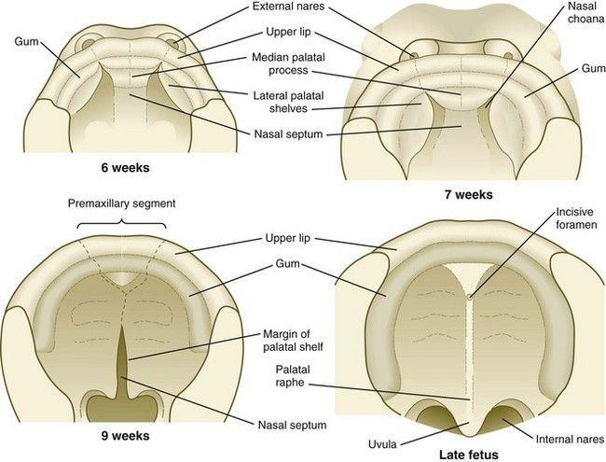
Development of the palate as seen from below

Slide 40
Formation of the palate involves
(1) growth of the palatal shelves,
(2) their elevation,
(3) their fusion, and
(4) removal of the epithelial at the site of fusion
The lateral palatine processes, which are the precursors of the secondary palate, first appear as outgrowths of the maxillary processes during the sixth week.
At first, they grow downward on either side of the tongue.
Similar to other facial primordia, outgrowth of the palatal shelves involves ectodermal-mesenchymal interactions and specific growth factors.
During week 7, the lateral palatine processes (palatal shelves) dramatically dislodge from their positions alongside the tongue and become oriented perpendicularly to the maxillary processes.
The mechanism underlying the elevation of the palatine shelves remains obscure.
The apices of these processes meet in the midline and begin to fuse.

Slide 41
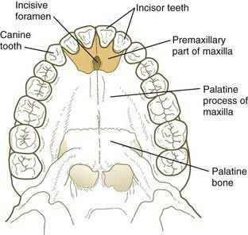
Postnatal bony palate, showing the premaxillary segment

Slide 42
The nasal septum, a midline downgrowth structure from the frontonasal prominence reaches the level of the palatal shelves when the palatal shelves fuse to form the definitive secondary palate.
The nasal septum is also continuous with the primary palate.
The fusion of the free lower edge of the nasal septum with forming palate separates the two nasal cavities from each other, while the palate separate them from the mouth.
The midline point of the fusion of the primary palate with the two palatal shelves is marked by the midpalatal suture and incisive foramen.
During the process of fusion, the midline abutting epithelial disappears.
The epithelium on the nasal surface of the palate differentiates into a ciliated columnar type, whereas the epithelium on the oral surface of the palate differentiates into a stratified squamous epithelium.
Their fusion begins anteriorly and proceeds backwards.

Slide 43
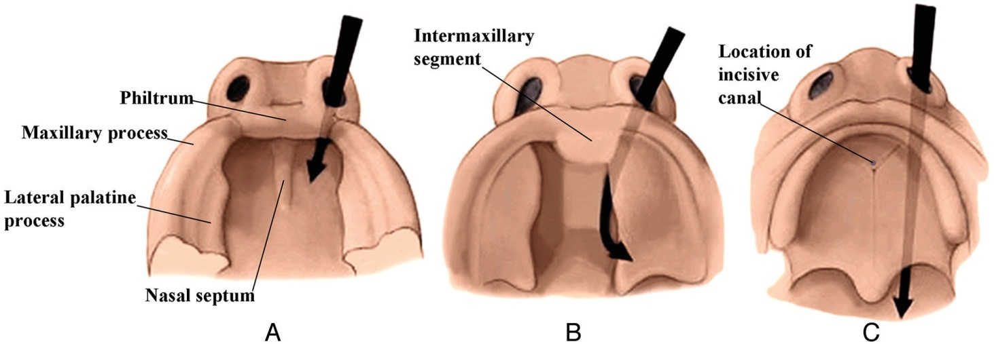
Drawings from below show the development of the palate from 6 to 7 weeks (A), 7 to 8 weeks (B), and 8 to 10 weeks (C).

Slide 44
At a later stage, the mesenchyme in the palate undergoes intramembranous ossification to form the hard palate.
However, ossification does not extend into the most posterior portion, which remains as the soft palate and midline uvula.
Initially the hard palate is a flat unarched roof to the mouth.
Later, the depth of the palatal arch increases cranially in association with tooth eruption.

Slide 45
Congenital malformations of the lip and palate
Congenital defects in relation to failure of fusion or incomplete development of the components of the face and palate are common and more frequent in males.
The causes, besides the hereditary trend (20-30%) in the same family, may be due to maternal infection during pregnancy (virus), alcoholism or dietry deficiencies.
Cleft Lip and Palate
Cleft lip or harelip is due to defective fusion between the maxillary and nasomedial processes and can be unilateral or bilateral.
The defect may be partial, involving only the lips (1in 1000 birth), or total, extending into the nasal fossa with involvement of the alveolar ridge.
The nose is deviated and there is flattering of the ala of the affected side.
If the parents are healthy but have one child with harelip, the probability of a second child with the same defect lies between the 4% and 7%.
If one of the parents is affected by harelip the probability for a second child with cleft lip is between 11% and 14%.
In the most complete form of cleft lip and palate, the entire premaxillary segment is separated from both maxillae, with resulting bilateral clefts that run through the lip and the upper jaw between the lateral incisors and the canine teeth.
The point of convergence of the two clefts is the incisive foramen.
The premaxillary segment commonly protrudes past the normal facial contours when viewed from the side.
The mechanism frequently underlying cleft lip is hypoplasia of the maxillary process that prevents contact between the maxillary and nasomedial processes from being established.

Slide 46
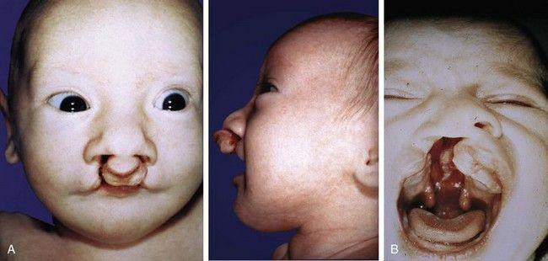
A, Front and lateral views of an infant with bilateral cleft lip and palate. On the lateral view, note how the premaxillary segment is tipped outward. B, Unilateral cleft lip and complete cleft palate. Note the duplicated uvula at the back of the oral cavity.

Slide 47
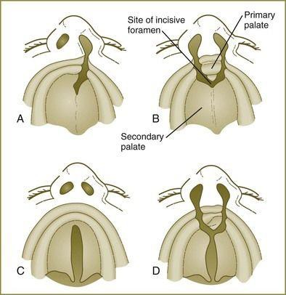
Common varieties of cleftlip and palate. A, Unilateral cleft passing through the lip and between the premaxilla (primary palate) and secondary palate. B, Bilateral cleft lip and palate similar to that seen in the patient in Figure 14.19A. C, Midline palatal cleft. D, Bilateral cleft lip and palate continuous with a midline cleft of the secondary palate

Slide 48
Cleft palate or palatoschisis is caused by failure of the palatine processes (palatal shelves) to fuse with an incidence of approximately 1 in 2500 births.
The deformity can be partial, involving only the uvula, part or all of the hard and soft palates, or complete in which the alveolar ridges are also affected.
As with cleft lip, cleft palate cause is usually multifactorial.
Some chromosomal syndromes (e.g., trisomy 13) are characterized by a high incidence of clefts.
In other cases, cleft lip and cleft palate can be linked to the action of a chemical teratogen (e.g., anticonvulsant medications).
In humans, mutations of MSX1 are strongly associated with nonsyndromic cleft palate.
The higher female incidence of cleft palate may be related to the occurrence of fusion of the palatal shelves in female embryos about 1 week later than in male embryos, thus prolonging the susceptible period.
The genetic and molecular basis of normal palate closure is complex.
Even closure of the anterior and posterior parts of the palate operates under different combinations of molecular interactions.
Consequently, more than 300 genetic syndromes include cleft palate as part of the spectrum of disease.
In these cases there is extensive irregular dental occlusion with rotated and misplaced teeth.
These defects interfere with sucking, proper nutrition and later with development of speech.
Frequently, infections of the nasopharynx and ear are serious consequences.
Surgery attains good results in the harelip at 4-6 weeks of age and around the second year for cleft palate.
Oblique Facial Cleft
Oblique facial cleft is a rare defect that results when the maxillary process fails to fuse with the corresponding nasolateral process, usually resulting from hypoplasia of one of the tissue masses.
The result is a groove on the face along the line of the nasolacrimal duct.

Slide 49
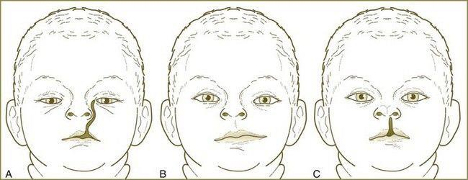
Varieties of facial clefts. A, Oblique facial cleft combined with a cleft lip. B, Macrostomia. C, Medial cleft lip with a partial nasal cleft.

Slide 50
Macrostomia (Lateral Facial Cleft) and microstomia
Macrostomia, a rare malformation results from hypoplasia or poor merging of the maxillary and mandibular processes.
This condition manifests as a very large mouth on one or both sides.
In severe cases, the cleft can reach almost to the ears.
Microstomia is an abnormally small mouth
Median Cleft Lip
Another rare anomaly, median cleft lip, results from incomplete merging of the two nasomedial processes.
First arch syndrome and other jaw defects
The entire first arch may remain underdeveloped on one or both sides, affecting the lower eyelid (coloboma type defect), the maxilla, the mandible, and the external ear.
The prominence of the cheek is absent and the ear may be displaced ventrally and caudally.
There may be presence of cleft palate and of faulty dentition.
This condition is called mandibulofacial dysostosis, Treacher Collins syndrome or first arch syndrome.
This is a genetic condition inherited as autosomal dominant.
The mandible may be small compared to the rest of the face resulting in a receding chin (retrognathia). In extreme cases it may fail to develop (agnathia).
Holoprosencephaly and face, nose and palate defects
Because of the significant role of influences from the forebrain in development of the face and associated structures, primary defects of the forebrain often manifest externally as facial malformations, typically a reduction in tissue of the frontonasal process.
Severe reduction in frontonasal process could result in cyclopia, absent nose or tubular proboscis.
Midline defects of the upper lip can also be attributed to holoprosencephaly.
Many cases of holoprosencephaly (e.g., Meckel’s syndrome, which includes midline cleft lip, olfactory bulb absence or hypoplasia, and nasal abnormalities) can be attributed to genetic causes.
Meckel’s syndrome is an autosomal recessive condition.
Other factors which have been associated with holoprosencephaly include: exposure to an excess of retinoic acid; maternal consumption of alcohol during the first month of pregnancy; maternal diabetes and trisomies of chromosomes 13 and 18.
Frontonasal Dysplasia
Frontonasal dysplasia encompasses various nasal malformations that result from excessive tissue in the frontonasal process.
The spectrum of anomalies usually includes a broad nasal bridge and hypertelorism (an excessive distance between the eyes).
In very severe cases, the two external nares are separated, often by several centimeters, and a median cleft lip can occur.
Torus palatines
This is genetically and anthropologically a bony growth in the midline of the hard palate which occurs in about 60% of the Eskimos.

Slide 51
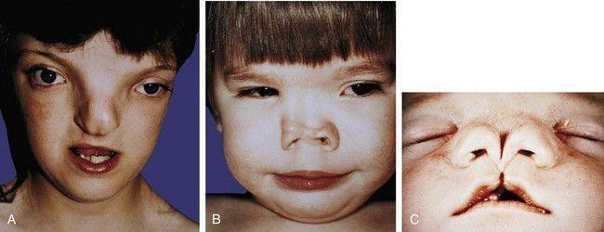
A to C, Varying degrees of frontonasal dysplasia

Slide 52
Remodeling and Postnatal growth of the face
During the early fetal period, the nose is flat, the mandible appears small, and the orbits face laterally.
As the brain enlarges, the cranial vault expands to each side causing the orbits to face forward.
The ostia of the external auditory canals remain stationary but appear to rise because the jaw elongates and grows downward.
Early on, the stomodeum extends across nearly the full width of the embryonic face.
Differential growth of the facial elements brings the eyes and lateral portions of the maxilla and mandible to a more frontal location.
Although the expansion of the cranial vault does make the mouth appear smaller, it is the formation of the cheeks by progressive fusion of the maxillary with the mandibular processes at the lateral angles of the mouth that most reduces the size of the mouth.
The coronal plane along which the oropharyngeal membrane originally attached eventually corresponds to the plane of the Waldeyer ring.
The progressive depth of this ring in the postnatal period is due to the dominant differential growth of the ventral face.

Slide 53
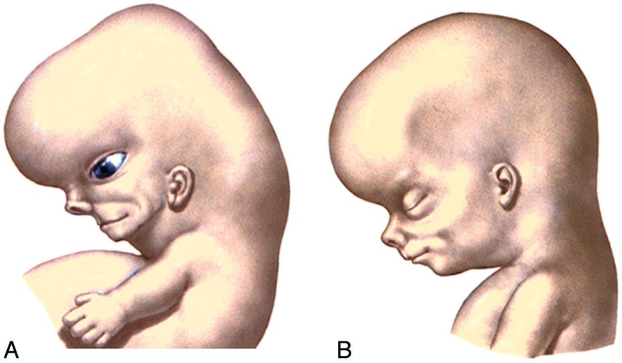
Lateral drawings of a 7- to 8-week embryo (A) and an 8- to 10-week fetus (B) show that the opening of the external auditory canal remains stationary but appears to rise because the progressive elongation of the jaw creates this impression.

Slide 54
Later Facial Growth
At birth, the skull has a sagittal suture system that divides the cranium and face into left and right halves.
Anteriorly, this system is made up of the metopic suture, the internasal suture, the intermaxillary suture, and the mandibular symphysis.
Posteriorly, the sagittal suture system splits around the body of the sphenoid bone, along the cartilage between the body of the sphenoid and the greater wings of the sphenoid.
The sagittal system does not bisect the entire skull because other midline structures basioccipit, basisphenoid, lesser wings of the sphenoid, the perpendicular plate of the ethmoid, and the interorbital portion of the frontal bone extend from the foramen magnum to the nasion.
By 8–9 weeks, the initial skeleton of the face is cartilaginous and composed of the nasal capsule in the upper face and Meckel cartilage in the lower face.
The chondrocranium forms the skull base.
By 12 weeks, most of the ossification centers have appeared in the membranous bones, and the enchondral ethmoid bone has started to ossify.
Ossification then proceeds within these bones.
During the late fetal period and until the first postnatal year, growth in the width of the craniofacial skeleton occurs at the midsagittal suture system.
The main mechanism of this growth is the progressive enlargement of the brain and growth of the cartilage between the body and greater wings of the sphenoid bone.
In the first year of life, the metopic suture unites, and soon after, the mandibular symphysis unites.
Then the greater sphenoid wings unite with the sphenoid body.
These changes close the midline sagittal suture system, and it ceases to be a growth site.
At approximately 3 years, ossification of the cribriform plates unites the ethmoid bodies with the perpendicular plate, creating a single ethmoid bone and stabilizing the interocular and upper nasal regions.
The progressive growth of the nasal septal cartilage “pushes” the midface forward and thus contributes to the facial anteroposterior growth.
After the third year, separation of the maxillary bones is still possible, as is separation of the zygomatic bone from the maxilla.
However, with completion of the growth of the orbits between the seventh and 10th years, further outward movement of the maxilla and zygoma ceases at these sutures.
Further growth of the upper facial skeleton takes place by surface bone deposition in association with internal bone resorption.

Slide 55
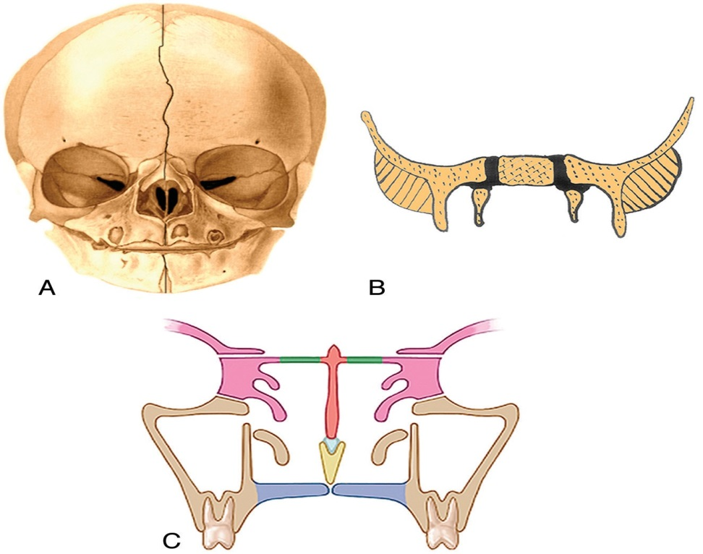
Frontal drawing of a neonate skull (A) shows the sagittal suture system that divides the cranium and face into 2 halves. B, Frontal drawing of the body of the sphenoid bone, the greater sphenoid wings, and the cartilage between them (black). C, Frontal drawing of the midfacial structures at approximately 3 years of age. The union of the ethmoid bodies (pink) with the perpendicular plate (orange) as a result of ossification of the cribriform plates (green) makes the ethmoid bone a single bone and stabilizes the interocular and upper nasal regions. The maxilla is beige; vomer, yellow; septal cartilage, light blue.

Slide 56
Childhood to Adulthood Facial Remodeling
As one ages from childhood to adulthood, there is a constant growth and remodeling of the facial bones, which results in changes in the facial morphology.
Overall, there is forward and downward growth of the face with progressing age.
Growth of the mandible begins later and continues longer than does the growth of the midface and orbits.
During the first decade of life, the forehead grows in an anterior and slightly upward direction. This contributes to the elevation and widening of the nasal bridge.
The zygomatic/maxillary region grows progressively posteriorly as the dental arch becomes elongated by addition of new bone on the posterior margin of the maxilla.
The part of the maxilla anterior to the zygomatic arch regresses while the posterior portion increases in size.
The backward movement of the malar region and the forward growth of the supraorbital region serve to draw out the anteroposterior dimensions of the face.
The inferior orbital rim and the superior orbital rim are in the same coronal plane in the young face, but in the older face, the supraorbital region protrudes forward of the cheek.
In the transverse plane, the maxillary bones and the ethmoid bodies grow apart from one another so that the interocular distance increases with age.
The movement of the nasal area combined with the malar movement results in an increase in the vertical size and the width of the upper part of each nasal cavity.
The mandibular ramus becomes progressively deeper in its anteroposterior dimension.
The ramus also increases in vertical dimension, accommodating the marked downward growth of the nasomaxillary complex and the eruption of the teeth.
The young face appears somewhat brachycephalic because it is relatively wide and vertically short. The dentition has not yet become fully established, and the jaws have not yet grown to their full vertical extent.
The young face also appears small compared with the cranium when the craniofacial sizes are compared with an adult skull.
Thus, compared with an adult face, the young face appears “cute,” with wide-set large eyes, a small jaw, a small “pug” nose, prominent cheeks, a high flat forehead without full eyebrows ridges, a low nasal bridge, and a small mouth.

Slide 57
The growth of the face is characterized by the initial rapid expansion of the upper third which is associated with the development of the frontal lobes of the brain.
It is almost completed at the age of twelve years.
The middle and lower two thirds grow more slowly and their development is in relation to the respiratory needs, the influence of the masticatory apparatus and later to the eruption of the third molars. It is completed between the ages of 18-25 years.
The height and width of the face are also related to the growth of the eyes which separates the skeletal components at the frontomaxillary and frontozygomatic sutures.
The medial migration of the position of the eyes is due to the expansion of the frontal and temporal bones.
The shape of the face is determined by the nose cavity and as nasal septum.
Defective development of the septum results in a concave shape of the face. The nasal cavity also influences the growth and form of the face.
In the case of inadequate nasal respiration (hyperthrophy of the adenoids), the face appears narrow and pinched.
Permanent appearance is attained at about the age of 25 years.

Slide 58
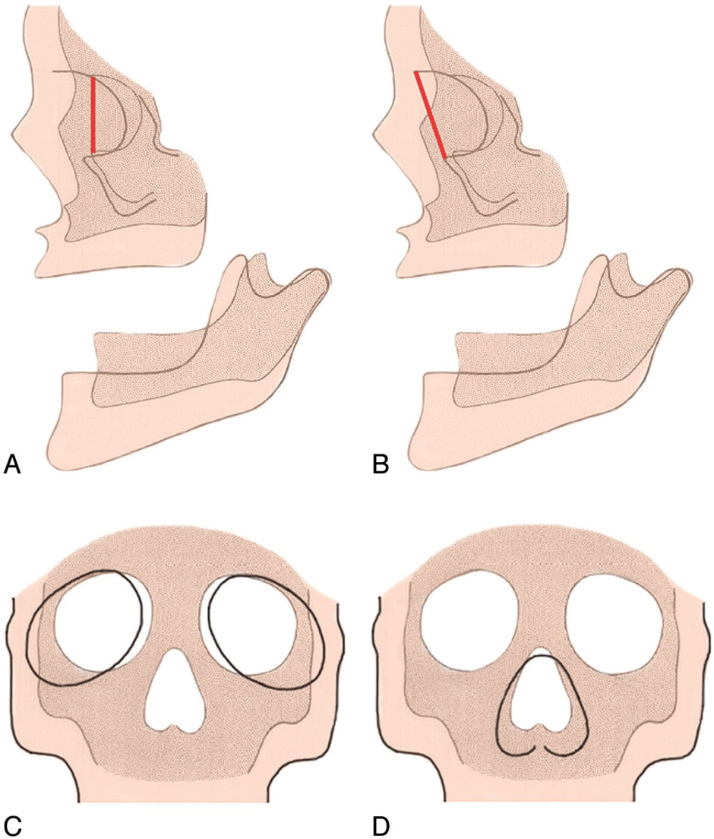
Lateral diagram of the fetal skull (A) (darker areas) and the adult skull (B) (lighter areas) shows that the inferior orbital rim and the superior orbital rim are in the same plane in the young face (dark line in A), but in the older face, the supraorbital region protrudes forward of the cheek (dark line in B). Frontal diagrams (C and D) show that as the maxillary bones and the ethmoid bodies separate from one another, this movement increases the lateral growth of the interocular distance. As a result, the orbits enlarge and shift laterally (C). The movement of the nasal area combined with the malar movement results in an increase in the vertical size and the width of the upper part of each nasal cavity (D).

Slide 59
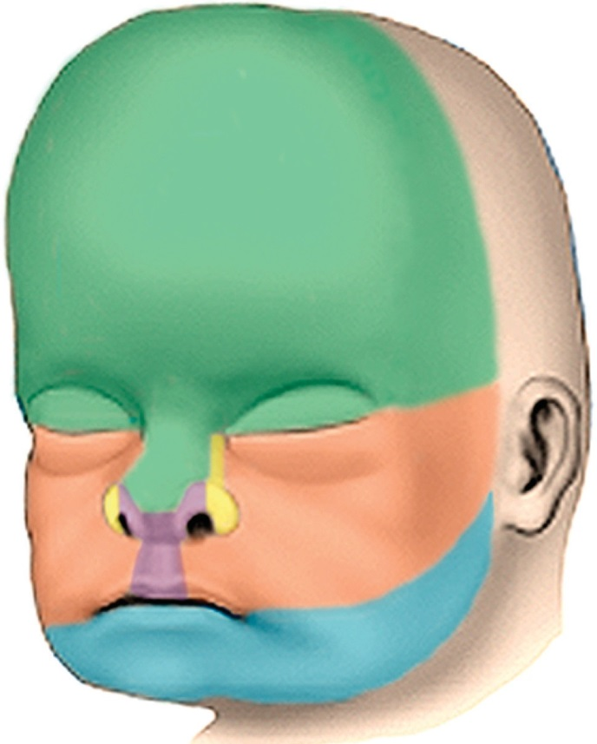
Drawing in an anterior oblique view of the late fetal face showing the contributions of the various facial processes. Green indicates the frontonasal process; yellow, the lateral nasal processes; purple, the medial nasal processes; orange, the maxillary processes; and blue, the mandibular processes

Slide 60
THANK YOU

